Slide 1
Course Code: CCINCOM/L
Linked List 2 (Double – Ended, Doubly LL, Circular )
Department of Computer Science
College of Computing and Information Technologies (CCIT)
National University
Joseph Marvin R. Imperial
DATA STRUCTURES AND ALGORITHMS
NU College of Computing and Information Technologies
Course Code: CCDATRCL

Slide 2
Recap: Linked List
The linked list is a versatile data structure which contains a collection of objects linked together by references from one object to another object.
It can be used as the basis for other data storage structures such as stacks and queues.
The second most commonly used general purpose storage structures after arrays.
In fact, you can use a linked list in many cases in which you use an array, unless you need frequent random access to individual items using an index.
Joseph Marvin R. Imperial
DATA STRUCTURES AND ALGORITHMS
NU College of Computing and Information Technologies
Course Code: CCDATRCL
Notes:
Linked lists aren’t the solution to all data storage problems, but they are surprisingly versatile and conceptually simpler than some other popular structures such as trees. We’ll investigate their strengths and weaknesses as we go along.

Slide 3
Link / Node
In a linked list, each data item is embedded in a link or node. A link is an object of a class specifically for items in the list.
Separate class for links / nodes, another separate class for the linked list itself.
Each Link object contains a reference (usually called next) to the next link in the list.
Joseph Marvin R. Imperial
DATA STRUCTURES AND ALGORITHMS
NU College of Computing and Information Technologies
Course Code: CCDATRCL

Slide 4
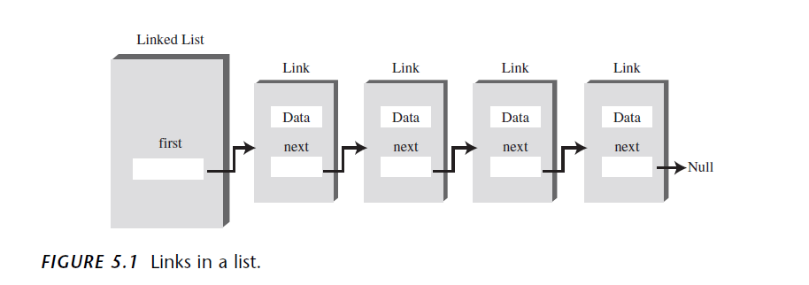
A linked list with nodes
Joseph Marvin R. Imperial
DATA STRUCTURES AND ALGORITHMS
NU College of Computing and Information Technologies
Course Code: CCDATRCL

Slide 5
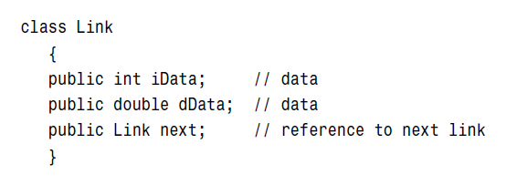
A Link / Node
This kind of class definition is sometimes called self-referential because it contains a field—called next in this case—of the same type as itself.
Joseph Marvin R. Imperial
DATA STRUCTURES AND ALGORITHMS
NU College of Computing and Information Technologies
Course Code: CCDATRCL

Slide 6
Referencing to other Links inside a Link
A Link object doesn’t really contain another Link object, although it may look like it does. The next field of type Link is only a reference to another link, not an object.
A reference is a number that refers to an object. It’s the object’s address in the computer’s memory, but you don’t need to know its value; you just treat it as a magic number that tells you where the object is.
Joseph Marvin R. Imperial
DATA STRUCTURES AND ALGORITHMS
NU College of Computing and Information Technologies
Course Code: CCDATRCL

Slide 7
Characteristics of Linked List
Linked lists as a data structure have the following characteristics:
Insertion is O(1) for the insert action
Deletion is O(n)
Searching is O(n)
Traversing is O(n)
O(n) – means proportional to size of the list or n
O(1) – constant time
Joseph Marvin R. Imperial
DATA STRUCTURES AND ALGORITHMS
NU College of Computing and Information Technologies
Course Code: CCDATRCL

Slide 8
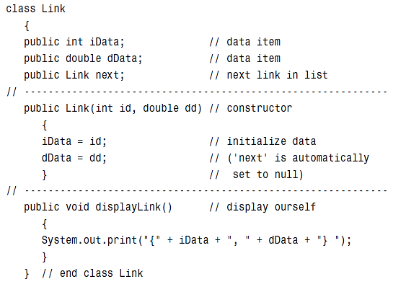
The Link / Node class
Joseph Marvin R. Imperial
DATA STRUCTURES AND ALGORITHMS
NU College of Computing and Information Technologies
Course Code: CCDATRCL

Slide 9
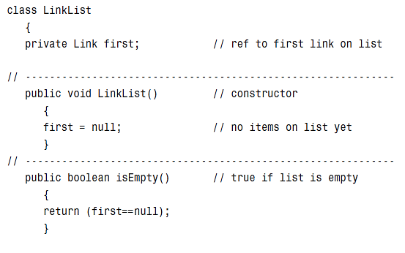

The LinkedList class
Joseph Marvin R. Imperial
DATA STRUCTURES AND ALGORITHMS
NU College of Computing and Information Technologies
Course Code: CCDATRCL

Slide 10
Double-Ended Linked List
A double-ended list is similar to an ordinary linked list, but it has one additional feature: a reference to the last link as well as to the first.
The reference to the last link permits you to insert a new link directly at the end of the list as well as at the beginning.
Of course, you can insert a new link at the end of an ordinary single-ended list by iterating through the entire list until you reach the end, but this approach is inefficient.
Joseph Marvin R. Imperial
DATA STRUCTURES AND ALGORITHMS
NU College of Computing and Information Technologies
Course Code: CCDATRCL

Slide 11
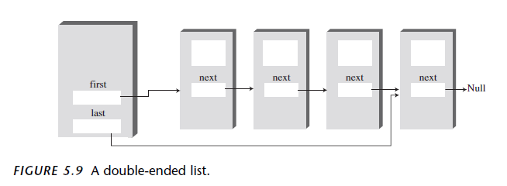
Double-Ended Linked List
Joseph Marvin R. Imperial
DATA STRUCTURES AND ALGORITHMS
NU College of Computing and Information Technologies
Course Code: CCDATRCL

Slide 12
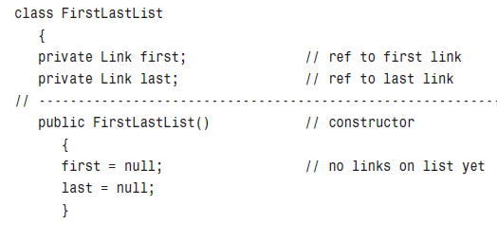
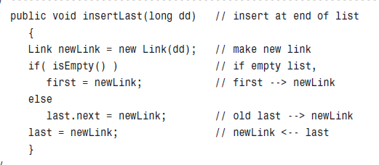
Joseph Marvin R. Imperial
DATA STRUCTURES AND ALGORITHMS
NU College of Computing and Information Technologies
Course Code: CCDATRCL

Slide 13
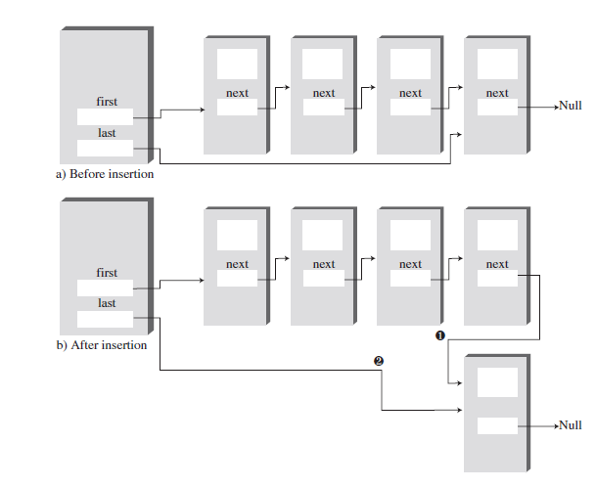
Joseph Marvin R. Imperial
DATA STRUCTURES AND ALGORITHMS
NU College of Computing and Information Technologies
Course Code: CCDATRCL

Slide 14
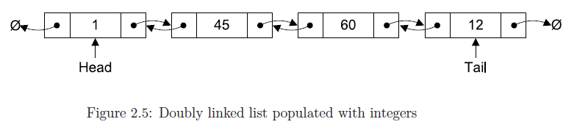
Doubly Linked List
Doubly linked lists are very similar to singly linked lists. The only difference is that each node has a reference to both the next and previous nodes in the list.
Joseph Marvin R. Imperial
DATA STRUCTURES AND ALGORITHMS
NU College of Computing and Information Technologies
Course Code: CCDATRCL

Slide 15
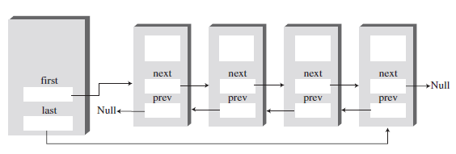
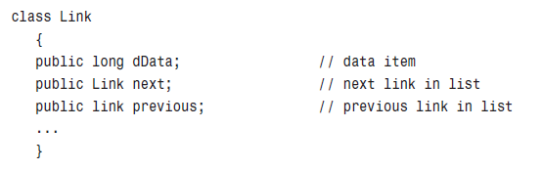
Doubly Linked List
Joseph Marvin R. Imperial
DATA STRUCTURES AND ALGORITHMS
NU College of Computing and Information Technologies
Course Code: CCDATRCL

Slide 16
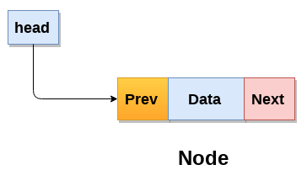
Doubly Linked List
Therefore, in a doubly linked list, a node consists of three parts:
Node data
pointer to the next Node in sequence (next reference)
pointer to the previous Node (previous reference)
Joseph Marvin R. Imperial
DATA STRUCTURES AND ALGORITHMS
NU College of Computing and Information Technologies
Course Code: CCDATRCL

Slide 17
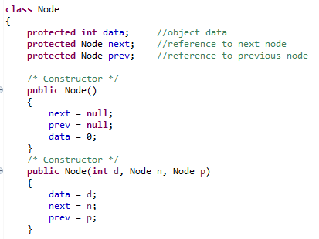
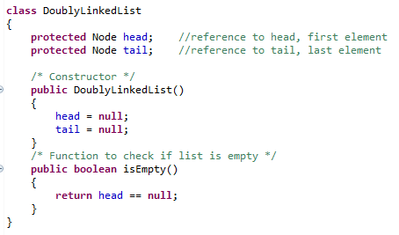
Joseph Marvin R. Imperial
DATA STRUCTURES AND ALGORITHMS
NU College of Computing and Information Technologies
Course Code: CCDATRCL

Slide 18
Operations
The following algorithms for the doubly linked list are exactly the same as those listed previously for the singly linked list:
Insertion
Deletion
Searching
Traversal (Forward and Backward)
Joseph Marvin R. Imperial
DATA STRUCTURES AND ALGORITHMS
NU College of Computing and Information Technologies
Course Code: CCDATRCL

Slide 19
Insertions
insertFirst() | inserts an element at the beginning of the list
insertLast() | inserts an element at the end of the list
insertAfter() | inserts following an element with a specified key
Joseph Marvin R. Imperial
DATA STRUCTURES AND ALGORITHMS
NU College of Computing and Information Technologies
Course Code: CCDATRCL

Slide 20
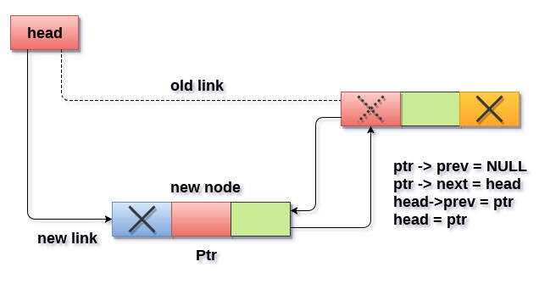
Insertion @ beginning
Joseph Marvin R. Imperial
DATA STRUCTURES AND ALGORITHMS
NU College of Computing and Information Technologies
Course Code: CCDATRCL

Slide 21
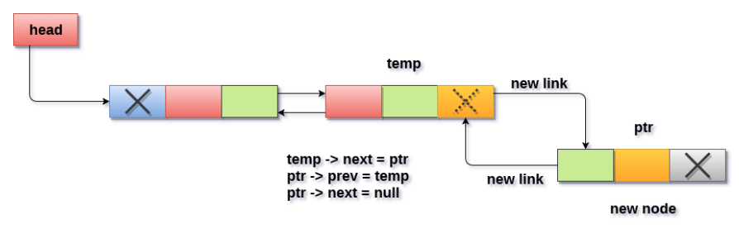
Insertion @ end
Joseph Marvin R. Imperial
DATA STRUCTURES AND ALGORITHMS
NU College of Computing and Information Technologies
Course Code: CCDATRCL

Slide 22
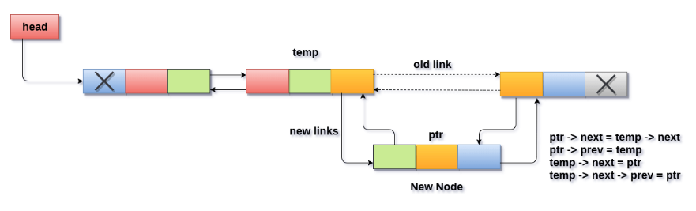
Insertion after specific node
Joseph Marvin R. Imperial
DATA STRUCTURES AND ALGORITHMS
NU College of Computing and Information Technologies
Course Code: CCDATRCL

Slide 23
Deletions
deleteFirst() | Delete first element.
deleteLast() | Delete last element.
deleteKey() | Delete element at key.
Joseph Marvin R. Imperial
DATA STRUCTURES AND ALGORITHMS
NU College of Computing and Information Technologies
Course Code: CCDATRCL

Slide 24
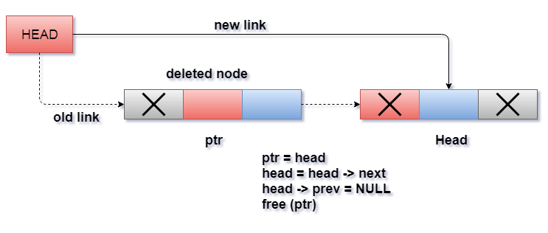
Deleting the head
Joseph Marvin R. Imperial
DATA STRUCTURES AND ALGORITHMS
NU College of Computing and Information Technologies
Course Code: CCDATRCL

Slide 25
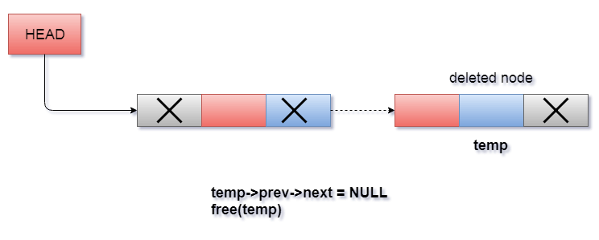
Deleting the tail
Joseph Marvin R. Imperial
DATA STRUCTURES AND ALGORITHMS
NU College of Computing and Information Technologies
Course Code: CCDATRCL

Slide 26
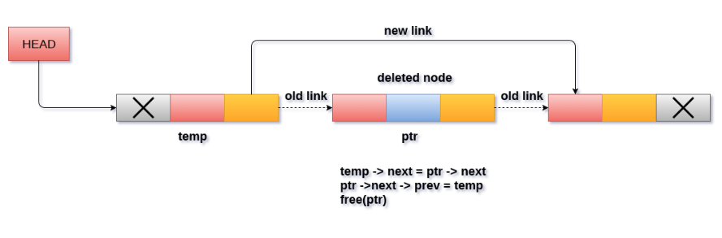
Deleting after a specific node
Joseph Marvin R. Imperial
DATA STRUCTURES AND ALGORITHMS
NU College of Computing and Information Technologies
Course Code: CCDATRCL

Slide 27
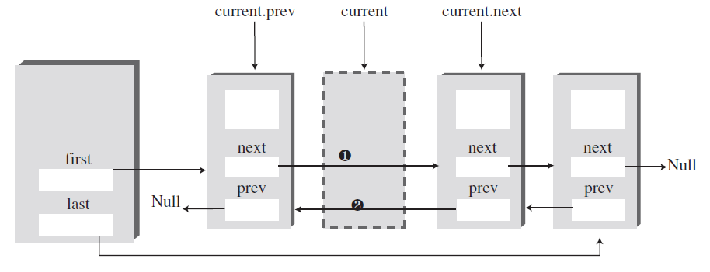
Deleting after a specific node
Joseph Marvin R. Imperial
DATA STRUCTURES AND ALGORITHMS
NU College of Computing and Information Technologies
Course Code: CCDATRCL

Slide 28
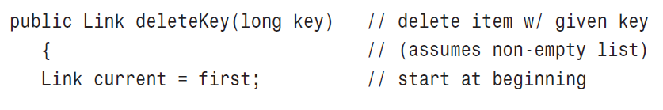
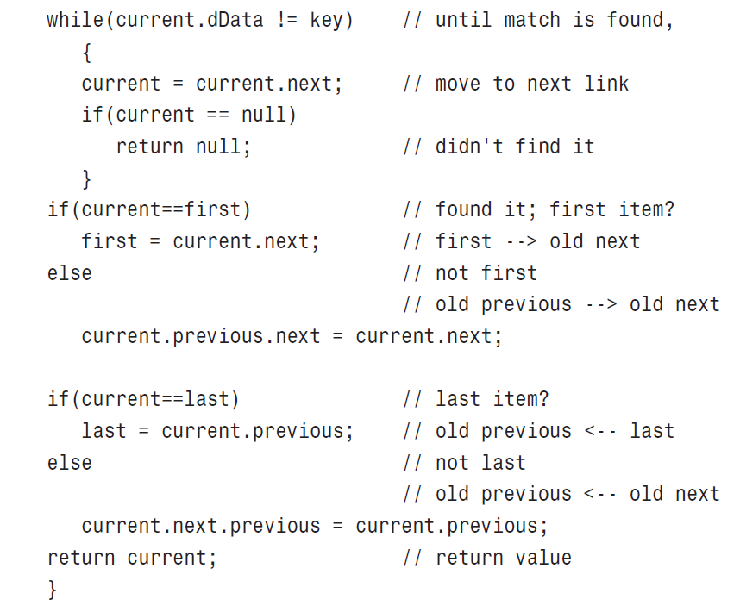
Deleting after a specific node
Joseph Marvin R. Imperial
DATA STRUCTURES AND ALGORITHMS
NU College of Computing and Information Technologies
Course Code: CCDATRCL

Slide 29
Advantages of Doubly LL
A doubly linked list can be traversed in both forward and backward direction.
The delete operation in doubly linked list is more efficient if pointer to the node to be deleted is given.
We can quickly insert a new node before a given node.
Reversing the list is simple and straightforward.
It is one of most efficient data structure to implement when traversing in both direction is required.
Joseph Marvin R. Imperial
DATA STRUCTURES AND ALGORITHMS
NU College of Computing and Information Technologies
Course Code: CCDATRCL

Slide 30
Disadvantages of Doubly LL
Every node of doubly linked list requires extra space for an previous pointer.
All operations require an extra pointer previous to be maintained.
Since elements in memory are stored randomly, hence elements are accessed sequentially no direct access is allowed.
Joseph Marvin R. Imperial
DATA STRUCTURES AND ALGORITHMS
NU College of Computing and Information Technologies
Course Code: CCDATRCL

Slide 31
Applications
Doubly linked list can be used in navigation systems where both front and back navigation is required.
It is used by browsers to implement backward and forward navigation of visited web pages i.e. back and forward button.
It is also used by various application to implement Undo and Redo functionality.
It can also be used to represent deck of cards in games.
It is also used to represent various states of a game.
Our DNA molecules are a combination of doubly linked list where each molecule knows about it’s previous and next siblings.
Joseph Marvin R. Imperial
DATA STRUCTURES AND ALGORITHMS
NU College of Computing and Information Technologies
Course Code: CCDATRCL

Slide 32
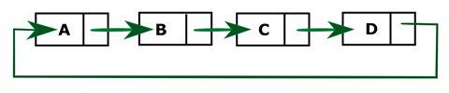
Circular Linked List
The circular linked list is the collection of nodes in which tail node also point back to head node.
With this simple change, we gain some benefits:
Any node in the circular linked list can be a starting point.
Consequently, the whole list can be traversed starting from any node.
Joseph Marvin R. Imperial
DATA STRUCTURES AND ALGORITHMS
NU College of Computing and Information Technologies
Course Code: CCDATRCL

Slide 33
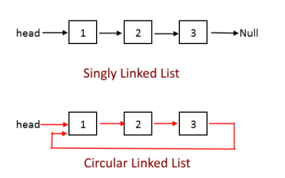
Circular Linked List
Same methods with singly linked list, the difference is the last node should point to the head.
Joseph Marvin R. Imperial
DATA STRUCTURES AND ALGORITHMS
NU College of Computing and Information Technologies
Course Code: CCDATRCL

Slide 34
Applications
The real life application where the circular linked list is used is our PCs or personal computers, where multiple applications are running. All the running applications are kept in a circular linked list and the OS gives a fixed time slot to all for running. The Operating System keeps on iterating over the linked list until all the applications are completed.
In multiplayer games, the players are kept in a circular linked list and the pointer keeps on moving forward as a player's chance ends.
Joseph Marvin R. Imperial
DATA STRUCTURES AND ALGORITHMS
NU College of Computing and Information Technologies
Course Code: CCDATRCL

